Slide 1






Overview
Semantic Role Identification: SRL assigns specific roles (e.g., agent, patient) to words or phrases in a sentence, revealing their semantic relationships with the predicate.
Enhances Text Understanding: SRL deepens the understanding of sentence meaning by analyzing the roles and contributions of words to the overall context.
Supports NLP Applications: SRL benefits information extraction, question answering, and machine translation by structuring and interpreting text based on semantic roles.
Powered by Machine Learning: SRL leverages machine learning models to predict semantic roles, using annotated data for training and improving accuracy in role assignment

Slide 2
Dataset, Embeddings and Models
Dataset
Embeddings
Models
Hindi treebank and Propbank
1600 sentences used
Word2Vec
FastText
Logistic Regression
SVC(Support Vector Machine)

Slide 3
Flowchart
Argument Identification
Pre-processing of data
Embeddings creating
Argument Classification

Slide 4
Argument Identification
Utilized lexical (embeddings, types, lemma), syntactic (POS tags, dependencies), and contextual features for word characterization.
We used a labeled dataset where each word in a sentence was labeled as either an argument or non-argument
Features were extracted for each word in the sentence.
Trained the model on extracted features.
Employed cross-validation methods to ensure model robustness and generalization
Evaluate precision, recall, and F1-score metrics, for the task of argument identification

Slide 5
Argument Classification
Use a model to assign semantic labels (e.g., Agent, Theme, Location) to identified arguments based on their role in the sentence.
Engineering features to capture lexical, syntactic, and contextual information for representing each identified argument effectively.
Training the model using a labeled dataset where each argument is associated with a specific Propbank label representing its semantic role.
Evaluating the classifier's performance using metrics such as accuracy, precision, recall, and F1-score to assess its effectiveness in assigning semantic roles to arguments.

Slide 6
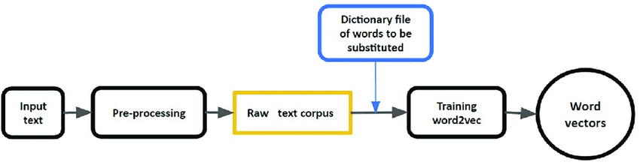
Word2Vec
Semantic Context: Word2Vec embeddings encode semantic meaning by representing words as dense vectors in a continuous space.
NLP Efficiency: Word2Vec embeddings enhance NLP tasks with efficient, context-aware word representations that preserve semantic relationships.

Slide 7
Pros & Cons
Pros:
Efficiently captures semantic relationships between words in a continuous vector space.
Provides dense and context-aware word representations beneficial for downstream NLP tasks.
Cons:
Requires large amounts of training data to learn accurate embeddings.
May struggle with out-of-vocabulary words and rare terms not encountered during training.

Slide 8
FastText
Subword Information: FastText embeddings capture morphological information by considering character n-grams, enabling it to handle out-of-vocabulary words and morphologically rich languages effectively.
Enhanced Generalization: FastText improves generalization by leveraging subword representations to encode semantic and syntactic information, benefiting tasks like text classification and named entity recognition.
Language Flexibility: FastText is adept at handling diverse linguistic patterns, making it suitable for languages with complex morphology where words share common prefixes or suffixes.
Efficient Training: Despite incorporating subword information, FastText remains computationally efficient, making it scalable to large datasets and practical for real-world NLP applications.

Slide 9
Pros and Cons
Pros:
Sub-word Information: Fast-Text generates embeddings based on character n-grams, allowing it to capture morphological variations and handle out-of-vocabulary words more effectively compared to traditional word embeddings.
Language Flexibility: FastText is well-suited for morphologically rich languages where words share common prefixes or suffixes. It can capture finer linguistic nuances and improve the performance of NLP tasks in these contexts.
Cons:
Increased Model Size: Including subword information can result in larger model sizes compared to traditional word embeddings like Word2Vec, which may require more memory and computational resources during training and inference.
Complexity and Training Time: Training FastText models with subword information can be more computationally intensive and time-consuming compared to simpler word-based embeddings, especially when dealing with large datasets or extensive vocabularies.

Slide 10
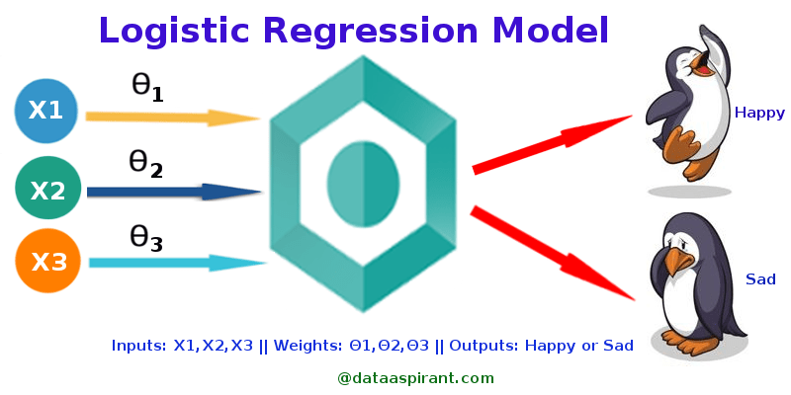
Logistic regression
Binary Classification:
Logistic regression is a popular statistical method used for binary classification tasks, where the goal is to predict a binary outcome (e.g., yes/no, true/false) based on input features.
Probabilistic Modeling:
Logistic regression models the probability of a binary outcome using a logistic (sigmoid) function, which outputs values between 0 and 1, representing the likelihood of the positive class.

Slide 11
Pros and Cons
Pros:
Interpretability: Logistic regression coefficients provide insights into the relationship between input variables and the probability of the outcome, allowing for easy interpretation of model results.
Efficient and Fast: Logistic regression is computationally efficient and scales well to large datasets making it suitable for quick model training and inference in binary classification tasks.
Cons:
Linear Decision Boundary: Logistic regression assumes a linear decision boundary between classes, which may not capture complex relationships in the data effectively.
Limited to Linear Relationships: Logistic regression is limited to modeling linear relationships between input variables and the log-odds of the outcome, which can be restrictive for capturing non-linear patterns in the data.

Slide 12
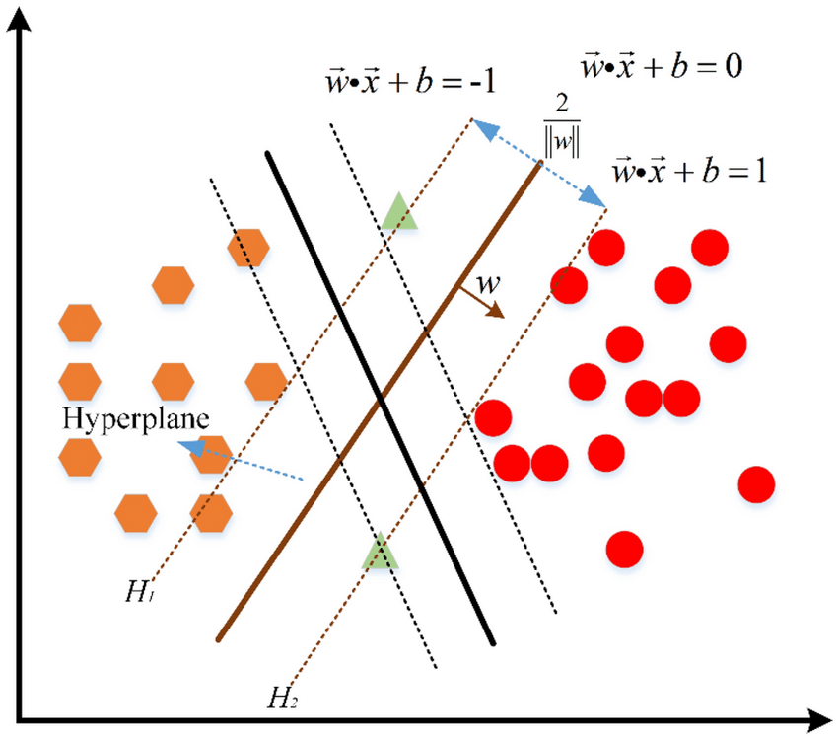
SVC
Effective for Non-linear Data: SVC is a powerful algorithm capable of finding complex decision boundaries by mapping data into higher-dimensional spaces using the kernel trick, which helps capture non-linear relationships between features.
Margin Maximization: SVC aims to maximize the margin (distance) between the decision boundary and the closest data points (support vectors), leading to better generalization performance and robustness against overfitting.

Slide 13
Pros and Cons
Pros:
Effective in High-Dimensional Spaces: SVC performs well in high-dimensional spaces, making it suitable for tasks with many features, such as image classification and text classification.
Robust to Overfitting: SVC maximizes the margin between classes, which helps in generalizing well to unseen data and reduces the risk of overfitting, especially when using appropriate regularization techniques.
Cons:
Computationally Intensive: SVC can be computationally expensive, especially with large datasets, as it involves solving a quadratic programming problem to determine the optimal decision boundary.
Sensitive to Noise and Outliers: SVC is sensitive to noisy data and outliers, as it tries to maximize the margin based on support vectors, which can lead to suboptimal performance if the dataset contains significant noise or outliers

Slide 14
Logistic regression with word2vec
Head with both Dependency
Identification
Classification
precision recall f1-score support
accuracy 0.83 4364
macro avg 0.83 0.84 0.83 4364
weighted avg 0.85 0.83 0.83 4364
precision recall f1-score support
accuracy 0.59 4364
macro avg 0.04 0.05 0.05 4364
weighted avg 0.41 0.59 0.48 4364

Slide 15
Logistic regression with FastText
Head with both Dependency
Identification
Classification
precision recall f1-score support
accuracy 0.82 4364
macro avg 0.81 0.82 0.81 4364
weighted avg 0.83 0.82 0.82 4364
precision recall f1-score support
accuracy 0.66 4364
macro avg 0.23 0.12 0.13 4364
weighted avg 0.60 0.66 0.61 4364

Slide 16
SVC with Word2Vec
Head with both Dependency
Identification
Classification
precision recall f1-score support
accuracy 0.83 4364
macro avg 0.82 0.84 0.83 4364
weighted avg 0.84 0.83 0.83 4364
precision recall f1-score support
accuracy 0.68 4364
macro avg 0.07 0.08 0.07 4364
weighted avg 0.54 0.68 0.59 4364

Slide 17
SVC with FastText
Head with both Dependency
Identification
Classification
precision recall f1-score support
accuracy 0.83 4364
macro avg 0.82 0.84 0.83 4364
weighted avg 0.84 0.83 0.83 4364
precision recall f1-score support
accuracy 0.70 4364
macro avg 0.19 0.12 0.12 4364
weighted avg 0.63 0.70 0.65 4364

